Slide 1
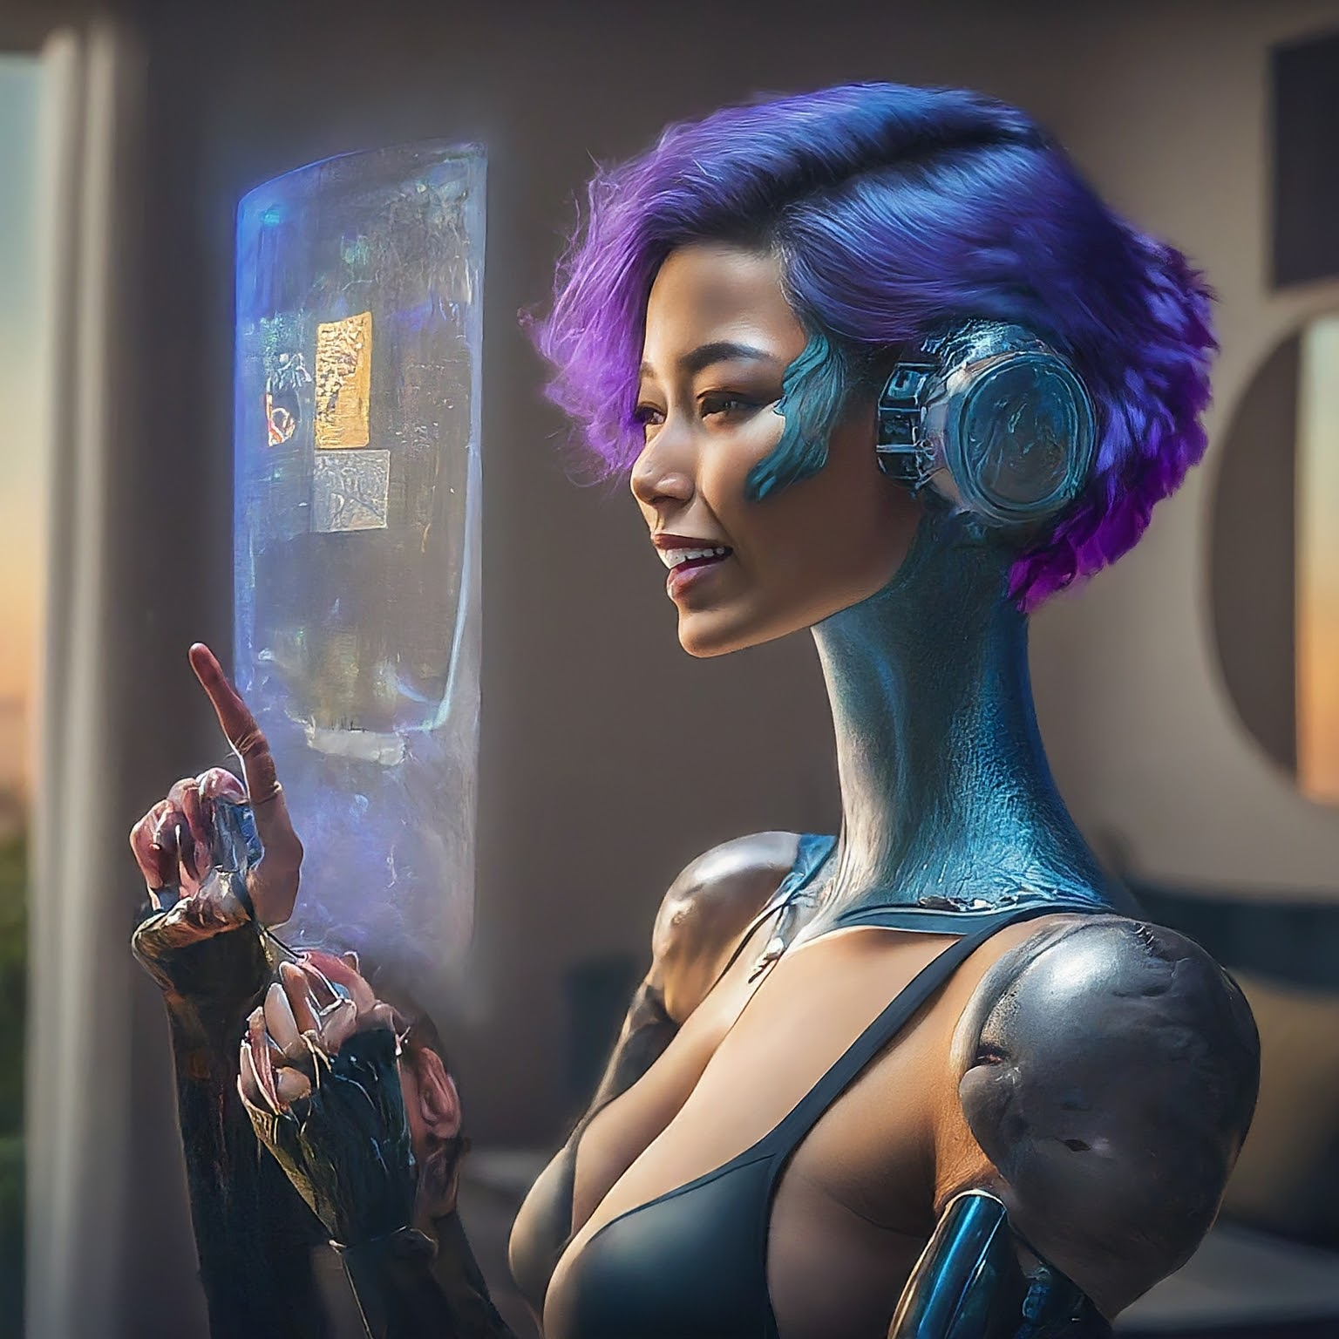

How to really use Google Gemini 1.5

Slide 2
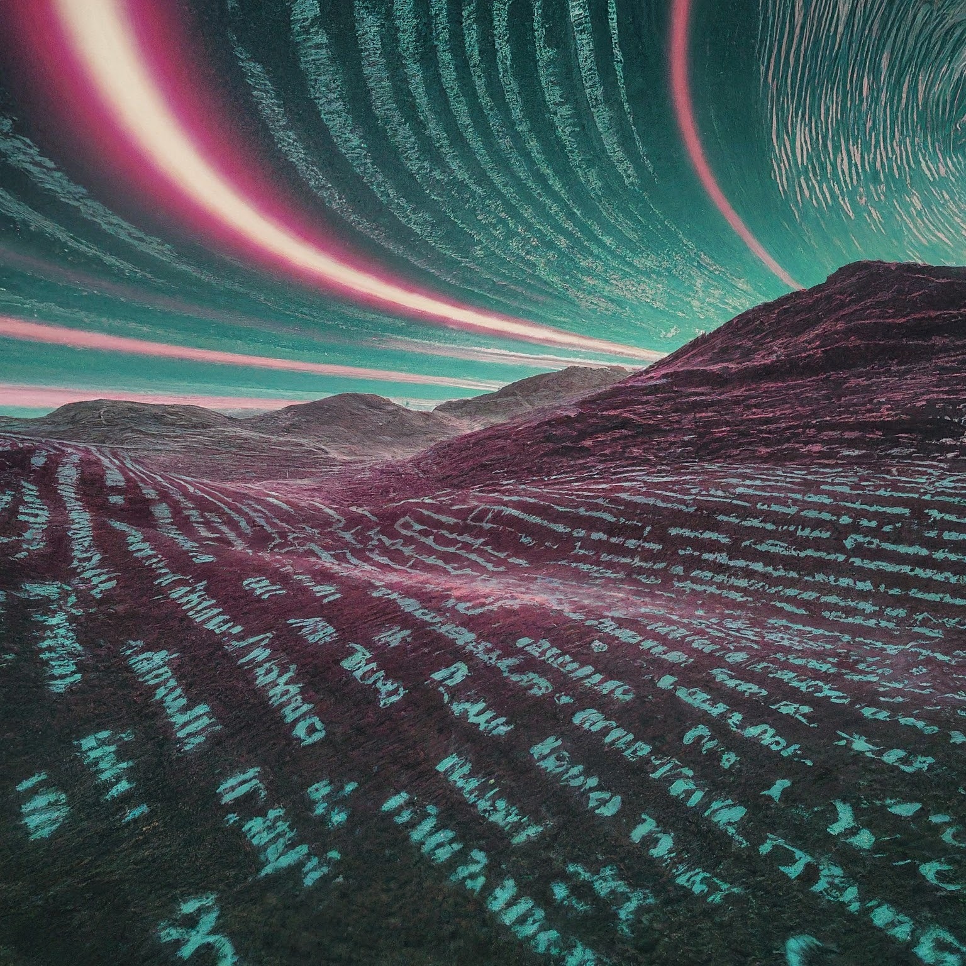
Text
Notes:
Create a story about an astronaut who travels to mars, and the year is 2030. Be creative and feel free to add fun/special twists. Make sure the story isn’t more than 200 words.
Explain black holes to me like I was in kindergarten
No you asshole, I meant for you to do this other thing

Slide 3
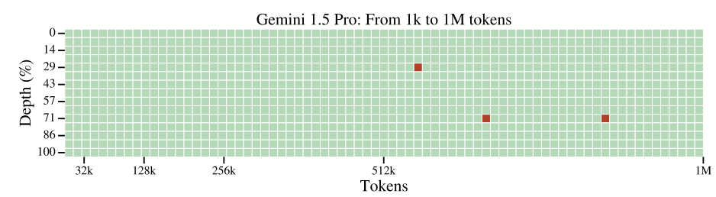
Needle in a haystack: Text
Notes:
https://storage.googleapis.com/deepmind-media/gemini/gemini_v1_5_report.pdf
Find all mentions of “oil can” in this book.

Slide 4
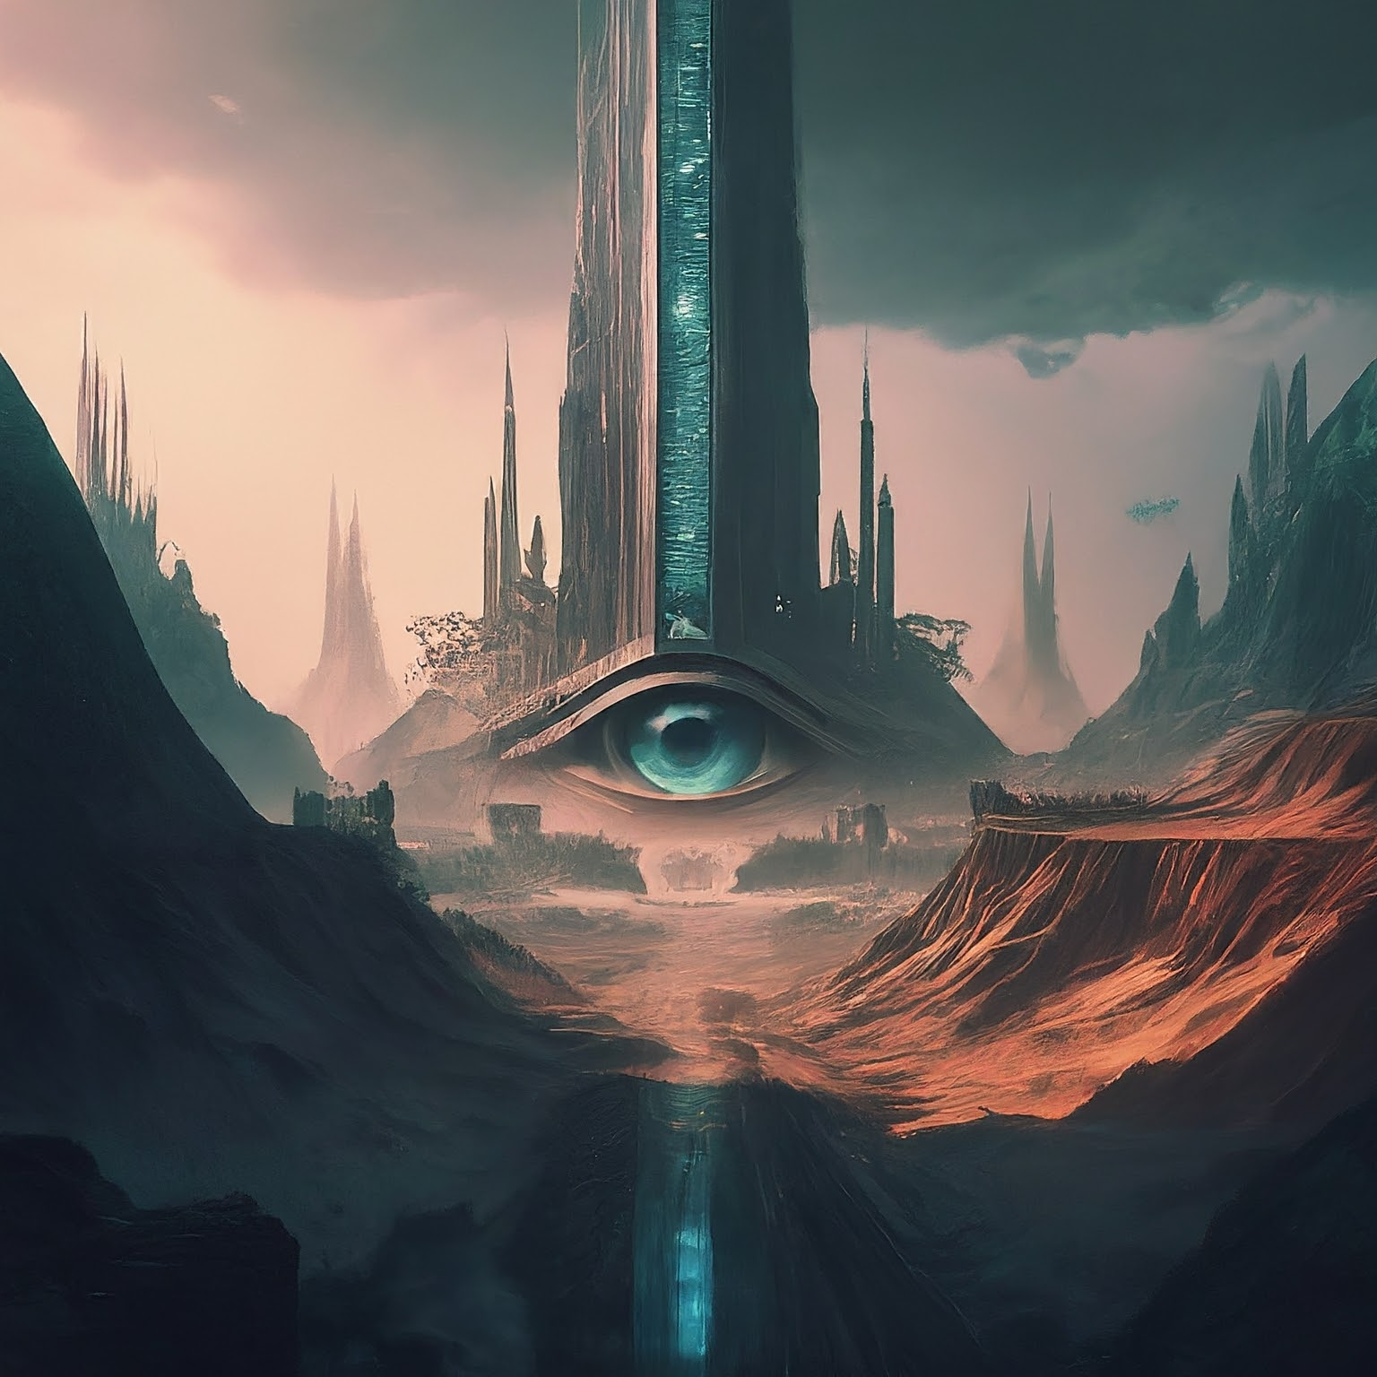
Vision

Slide 5
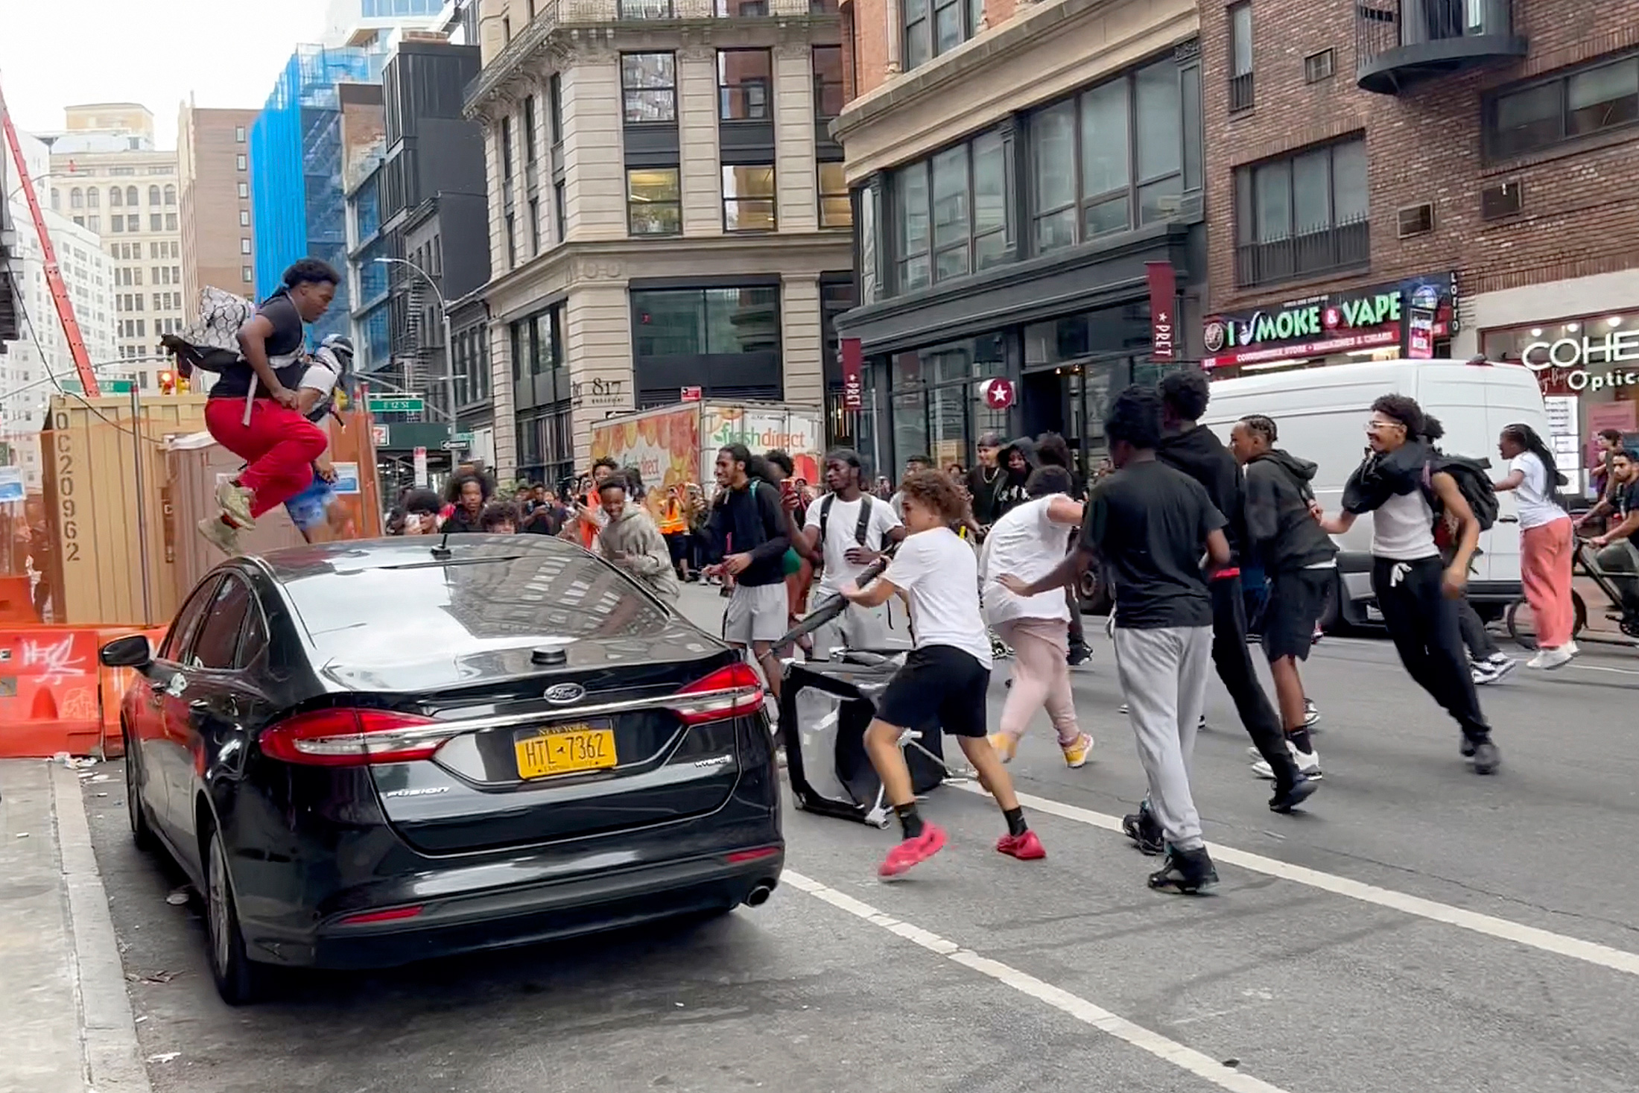
Identification

Slide 6
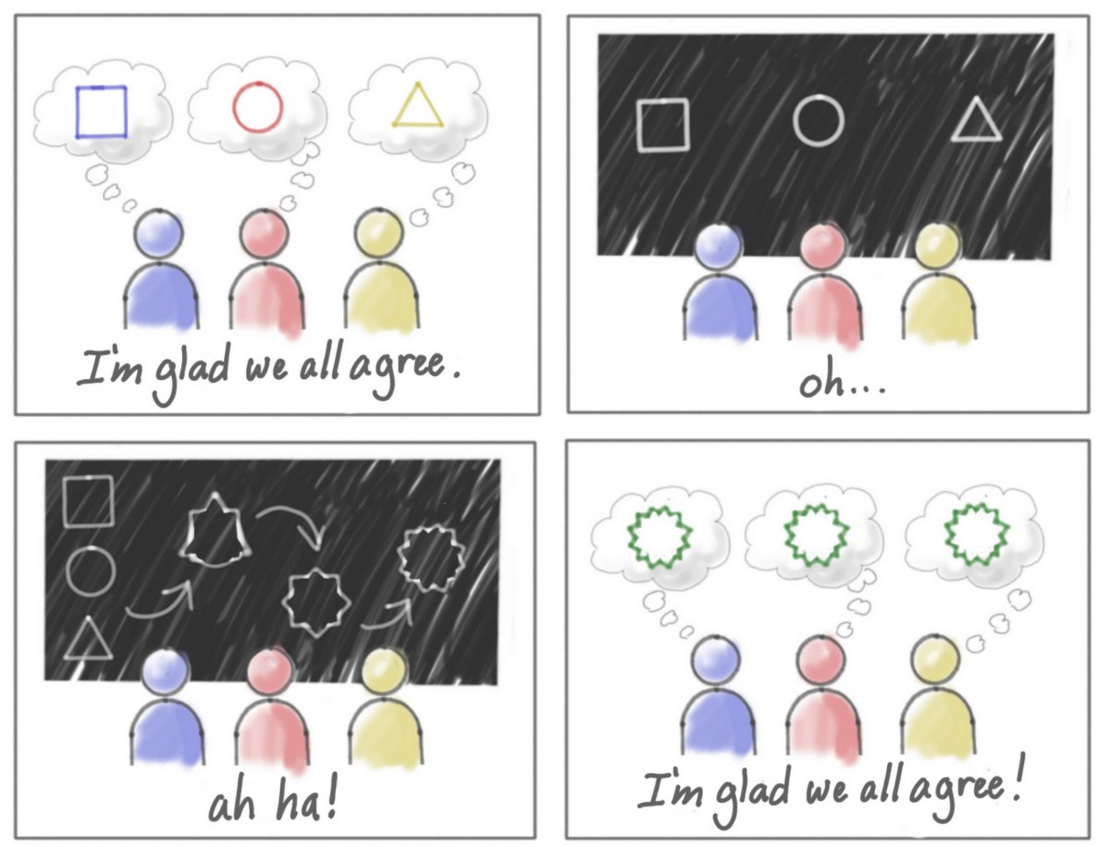
Abstract Ideas

Slide 7
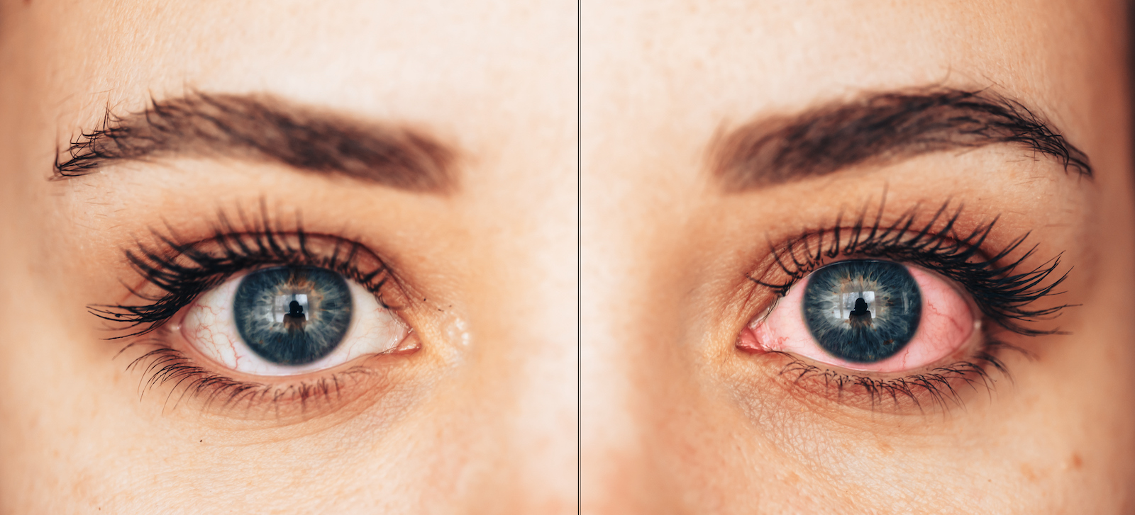
Medical

Slide 8
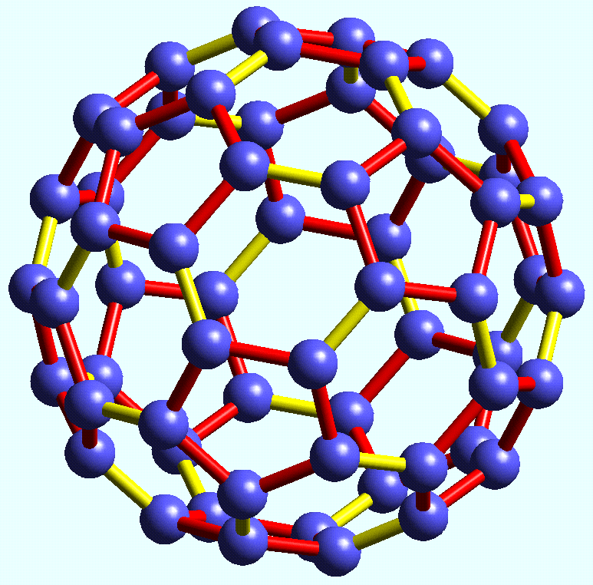
Chemistry

Slide 9
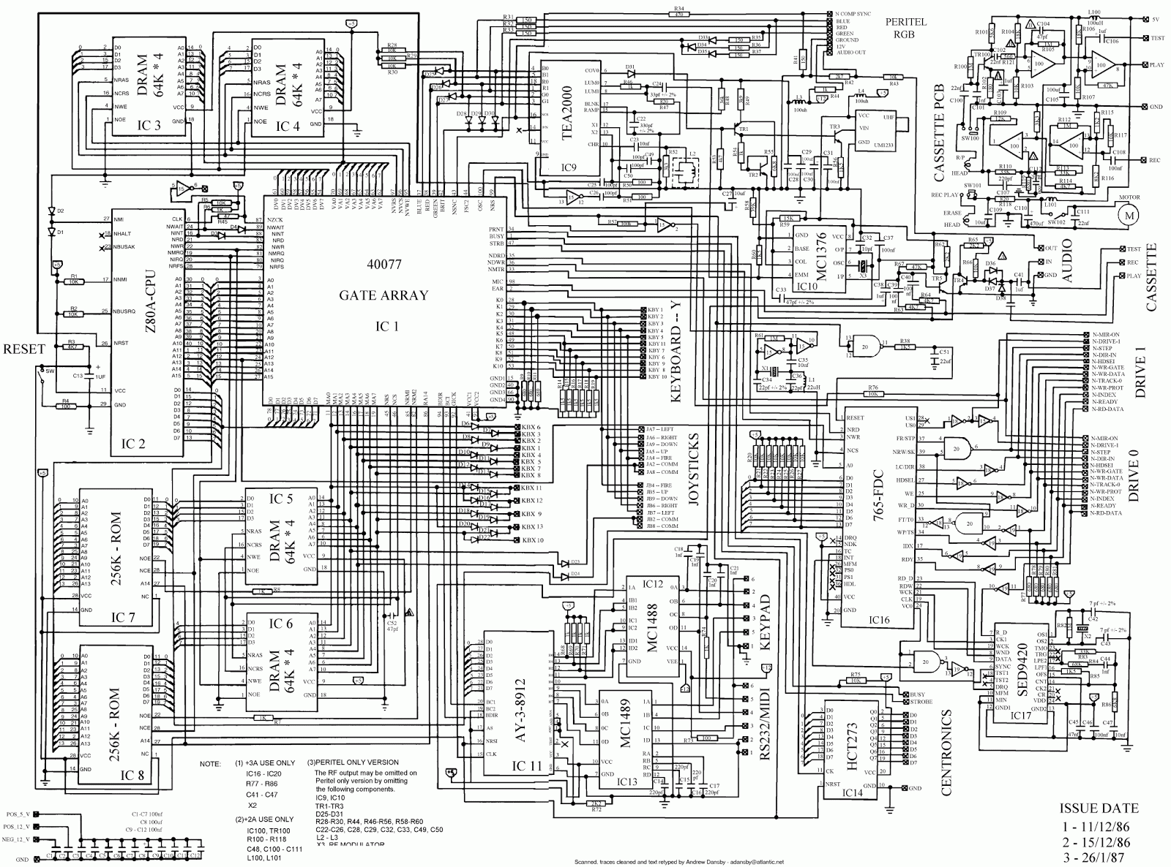
Electronics

Slide 10
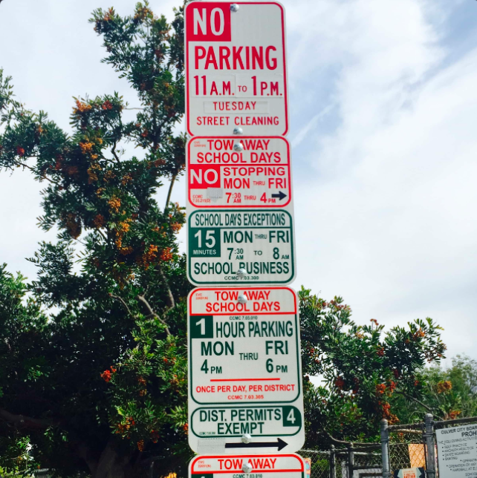
Parking

Slide 11
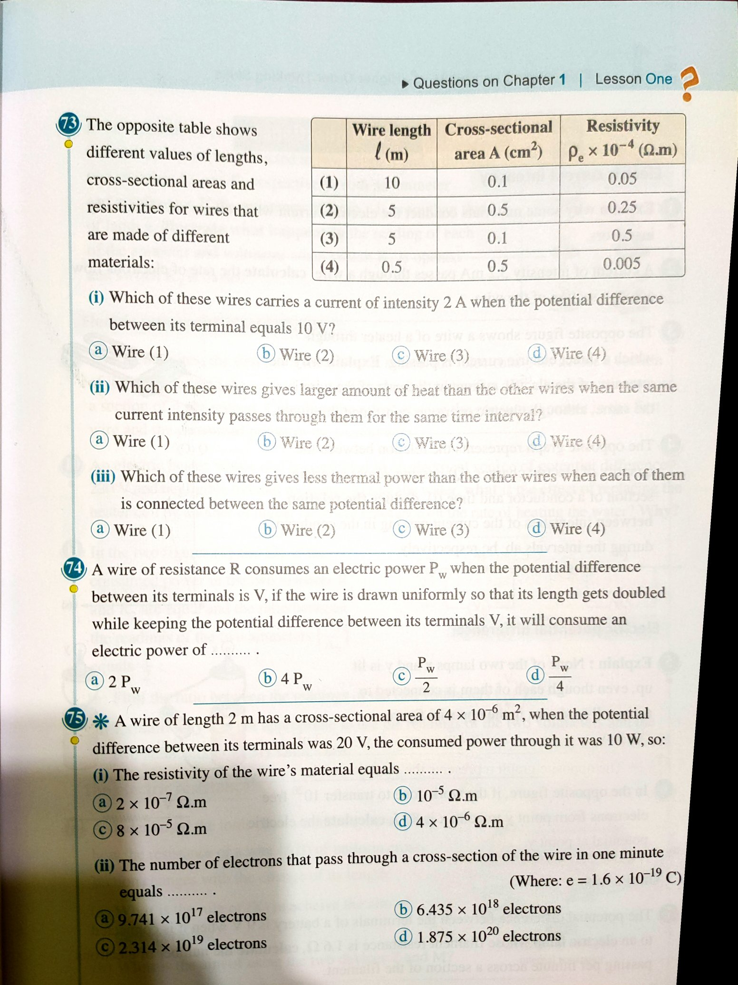
Homework

Slide 12
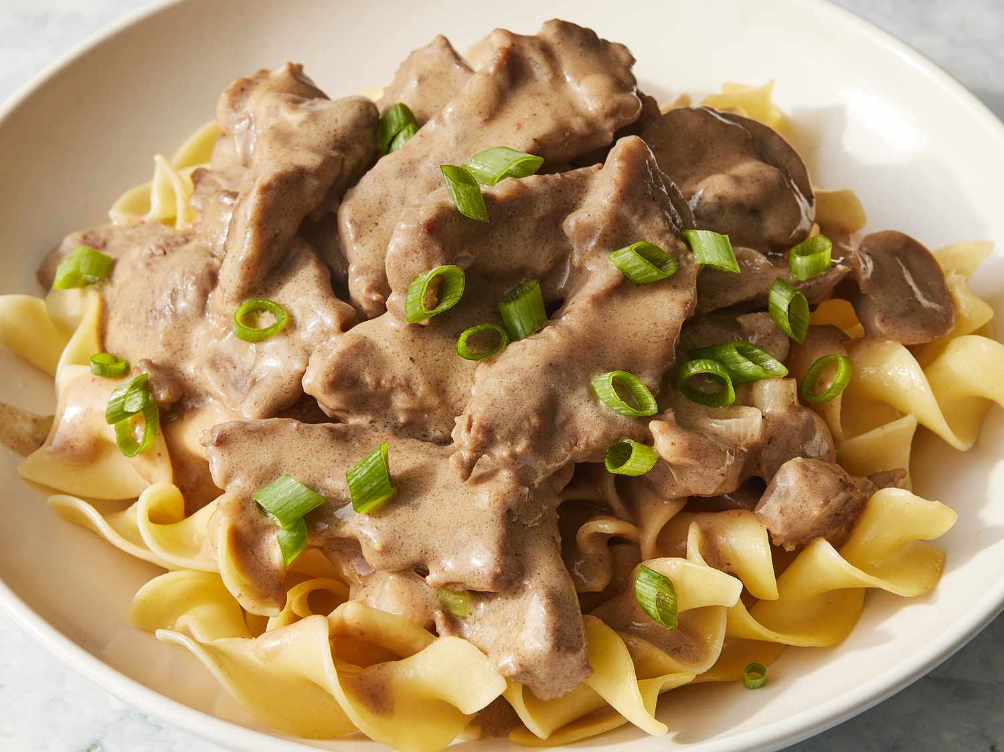
Cooking

Slide 13
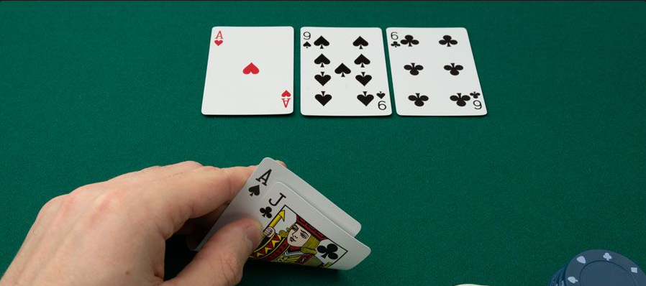
Poker

Slide 14
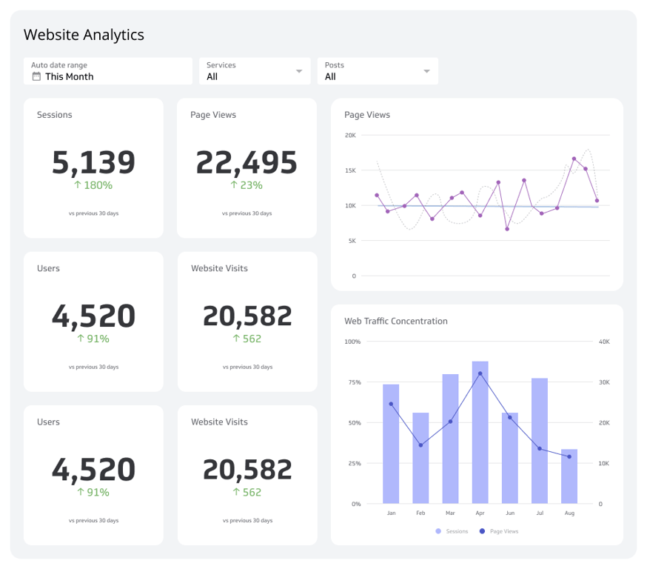
Code

Slide 15
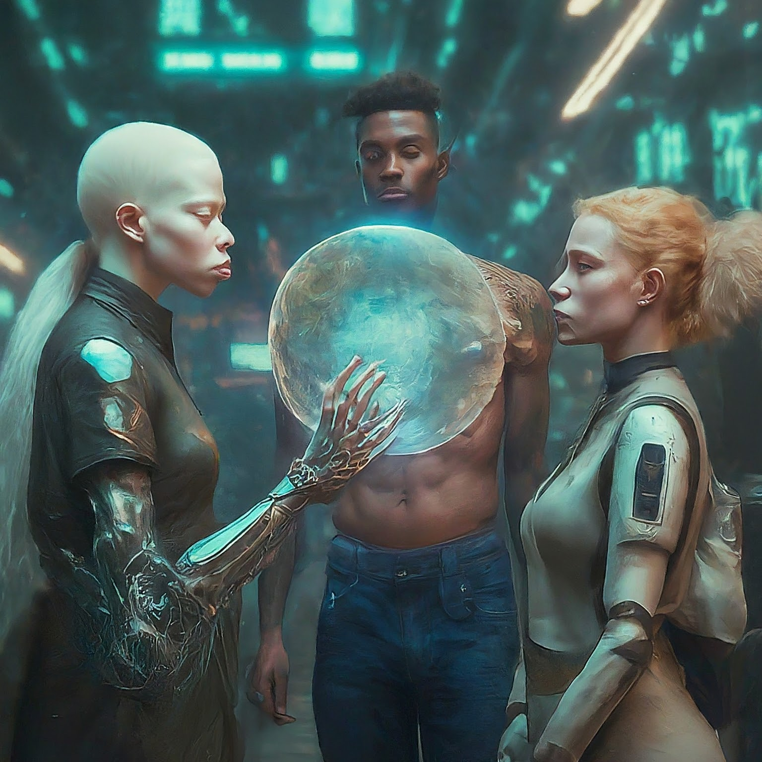
Browsing
Notes:
Search the web for gemini ultra best prompts
Search the web for the best beer rankings

Slide 16
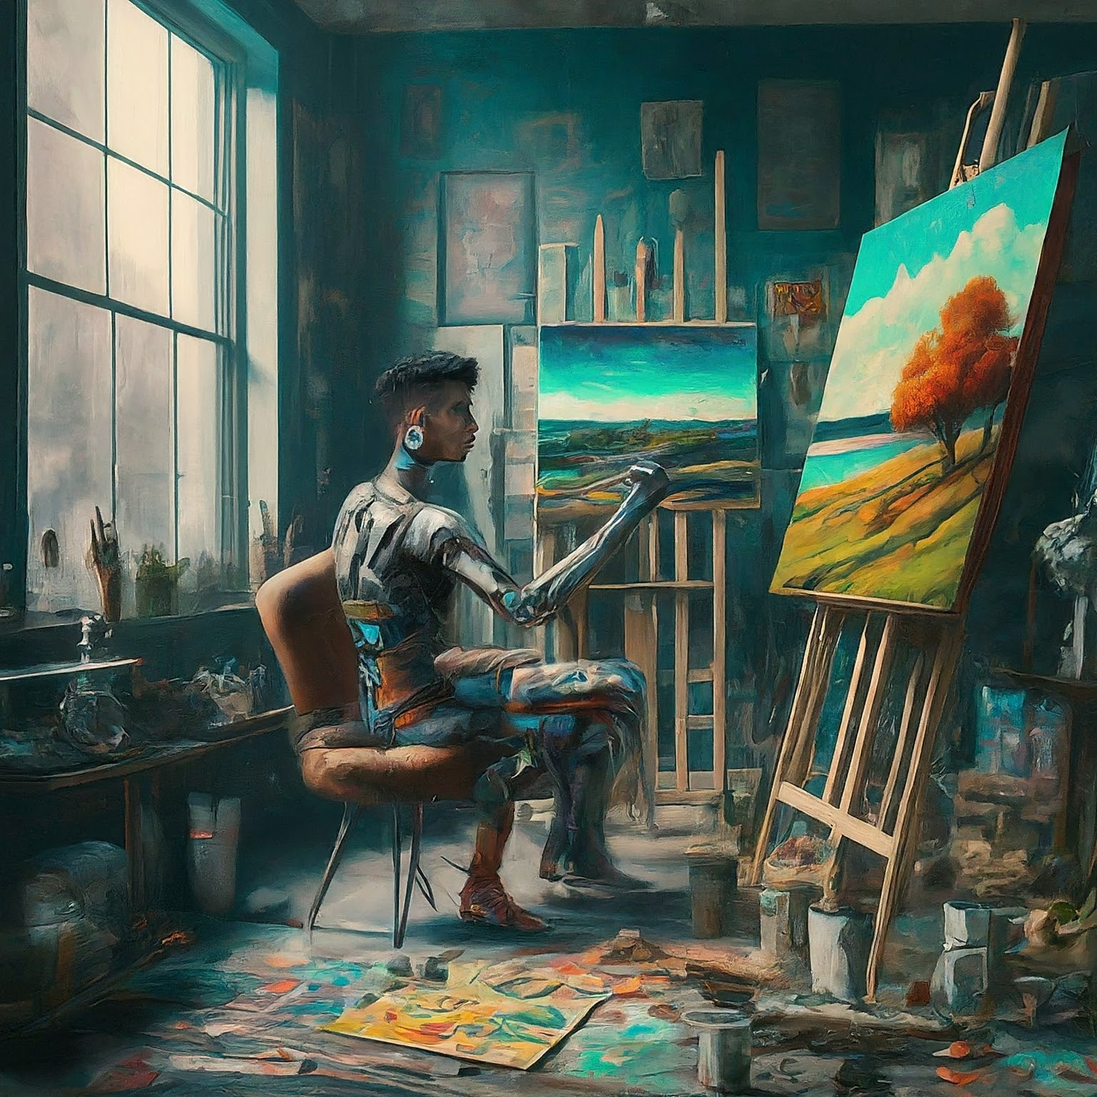
Image Generation
Notes:
Create a landscape view image of what I would see if I were looking at Earth from the surface of Mars.
Create an image of a dystopian cityscape with the word “Dystopian” written big and floating in the sky.

Slide 17
